Slide 1
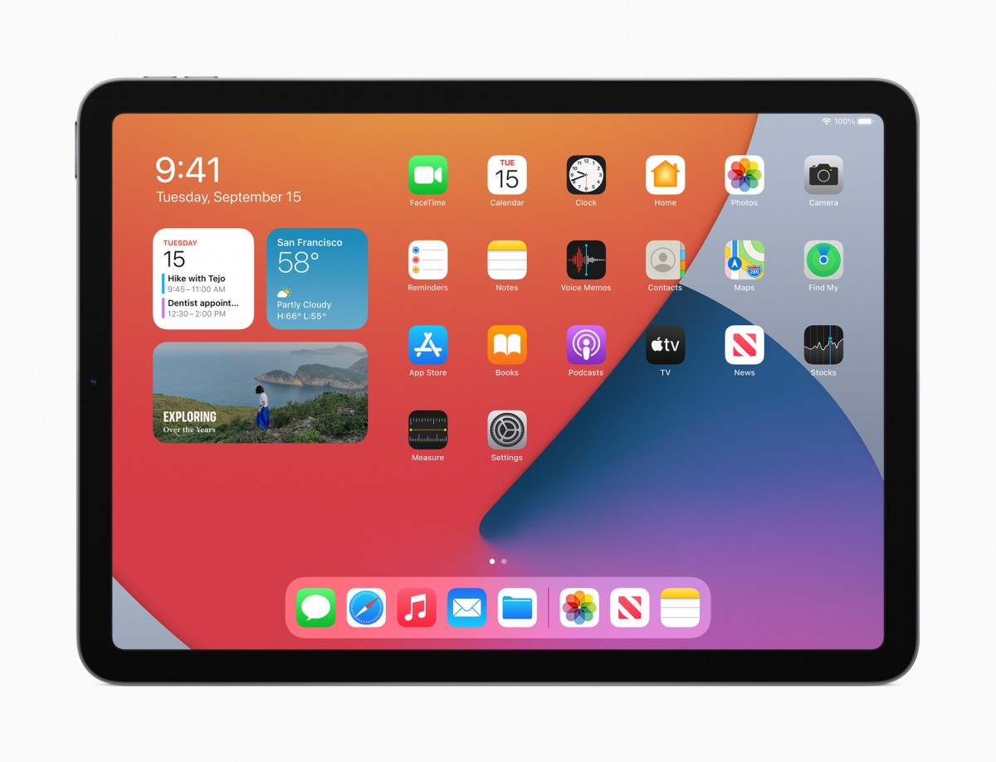
iPad Meeting – 2022
For parents of children in Year 3 2023
Image: https://au.pcmag.com/apple-ipad/68848/apple-ipad-2020

Slide 2
Acknowledgement of Country
We acknowledge the Whadjuk peoples of the Noongar nation,
the traditional custodians of this land.
We pay our respects to Elders,
who hold the memories, traditions, culture and hopes of Indigenous Australia.

Slide 3
Prayer
God our Father,
We thank You for St Thomas’ School and for all who make it a special place.
Bless the children, who are growing in the love of Jesus.
Bless our parents and teachers,
who help us to love and care for others and help us to learn.
We remember with thanks the Presentation Sisters who worked in our school.
We pray for our Parish of St Thomas’ the Apostle. May our school community always be a place of love, peace, learning and laughter.
We ask this through Christ our Lord
Amen

Slide 4
Purpose of the Meeting
Purchase of iPads
Set-up of the iPad
Support/Empower parents
Parents to reflect on how best to manage the device for their child

Slide 5
Why implement a 1:1 iPad Program in Year 3?

Slide 6
7x General Capabilities
ICT Capability

Slide 7
iPad 2023
All students entering into Year 3 in 2023 need an iPad
There are two options for purchasing
Winthrop Australia (Delivered to school or home)
Parents purchase own device
Current iPad supply interruptions

Slide 8
Words are important
Who ‘owns’ the iPad?
“The iPad that is used at school”
“The iPad your parents purchased for your learning”

Slide 9
iPad 2023 - Winthrop Australia
The order can be delivered to St Thomas' Primary School, or please deliver to the school on Friday 20 January 2023
The school will set-up management software, internet access, printing, distribution of educational apps
6 Months interest free option available
Multiple options available
https://sales.winaust.com.au/shop/stthomas

Slide 10
iPad 2023 – Specifications
Parents will be required to provide an iPad for their Year 3 child for 2023
We recommend 256GB 10.2inch Generation 9 (N.B. Gen 10 is not required, and is more expensive, for little gain in the classroom)
No iPad Pro 12.9inch, no iPad Mini, no 32GB model (no longer adequate for today’s applications)
Headphones are required (with in-built microphone – do not need new)
STM Cover/Case and screen protector – need solid protection for the device
Keyboard (optional, suggested) and stylus (optional)

Slide 11
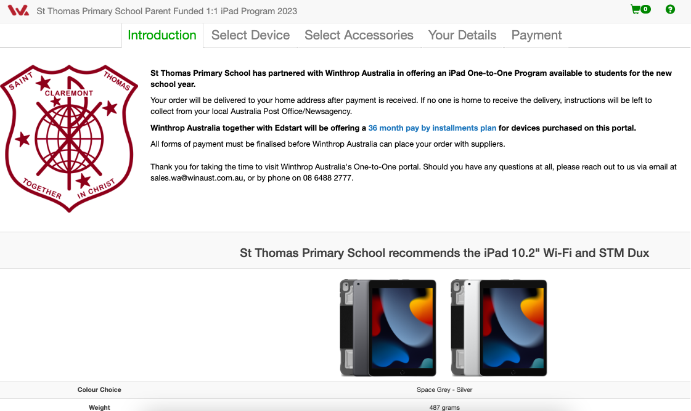
Ordering
https://sales.winaust.com.au/shop/stthomas

Slide 12
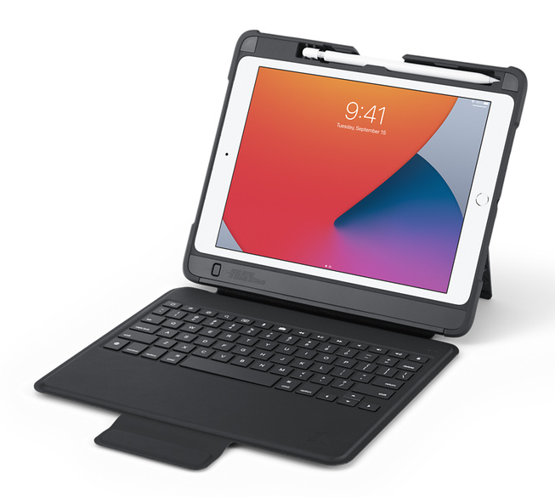
iPad 2022 – Specifications
Peripherals?

Slide 13
Management
If using an existing iPad – it must be wiped/reset to install JAMF
To remove the management software, the device must be wiped/reset

Slide 14
iPads at school
iPads stay at school for Term One, 2023.
Teachers are in charge - the school will load all apps required for educational purposes using ‘JamF School’.
Student iPads are connected to the school Wi-Fi network, under CEWA filters and monitoring, and Apple classroom live monitoring
JAMF Parent – app available for managing the device

Slide 15
When will they go home?

Slide 16
iPads at Home
Parents are in charge – your child wants boundaries
What you want for your child may be different to what other parents want for their child
You can say ‘no’!
Image: https://en.wikipedia.org/wiki/File:Uncle_Sam_(pointing_finger).png

Slide 17
At home you can …
Add an additional Apple account
Load apps – we have allowed user installed apps, but we encourage for educational reasons only
Access home WiFi
Add a screen time (4 digit) pin for home use only. However, it needs to be reset at the start of each year and shared with the classroom teacher for management purposes in the classroom
Parent support from school
Apple Care will cover your device at home (recommended)

Slide 18
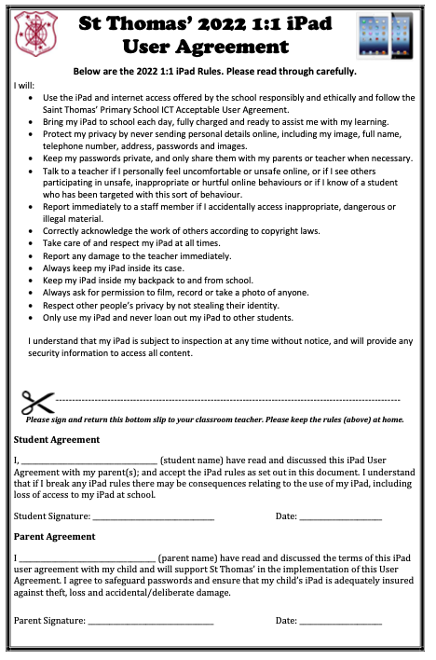
iPad User Agreement
- for school

Slide 19
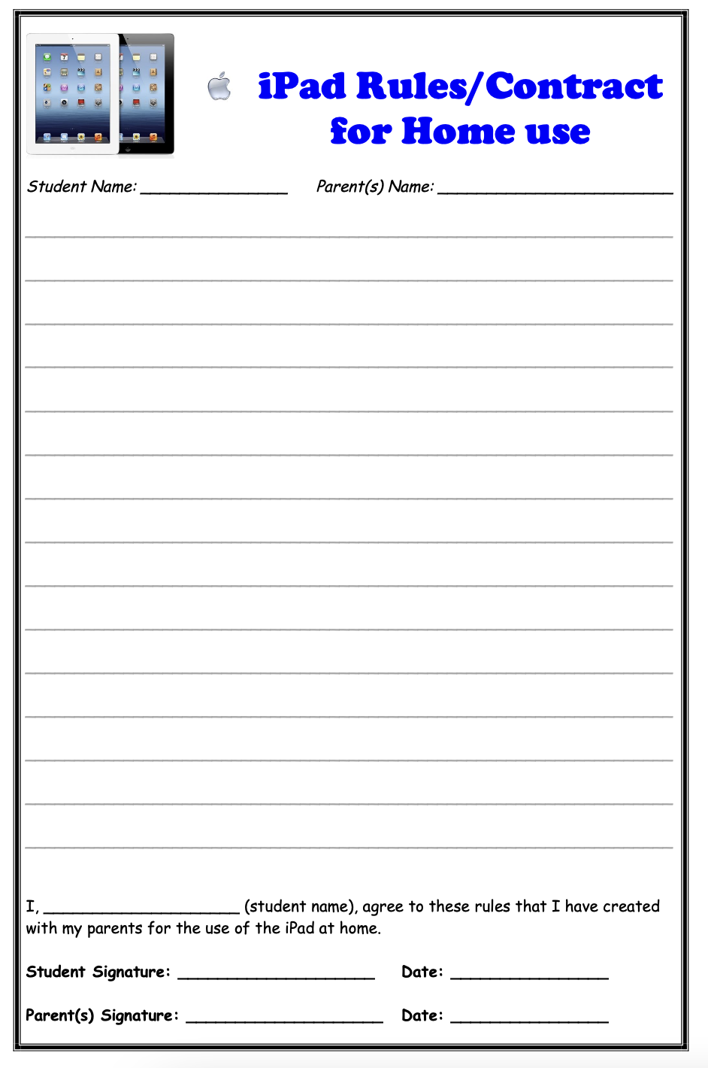
iPad Parent/Child Agreement
– for home
Develop in partnership with your child

Slide 20
Thank you for taking the time to attend
Questions
Contact Info
heath.nankivell@cewa.edu.au

